Slide 1
Special Services
Catering
Restaurant rental

Slide 2
Top Five Reasons to Buy from Us
Quality
Service
Freshness
Value
Quality!

Slide 3
Whole Grains Cafés
Open every day from 7:00 a.m. to 9:00 p.m.
Offering a wide range of soups, sandwiches, and salads
Franchises available

Slide 4
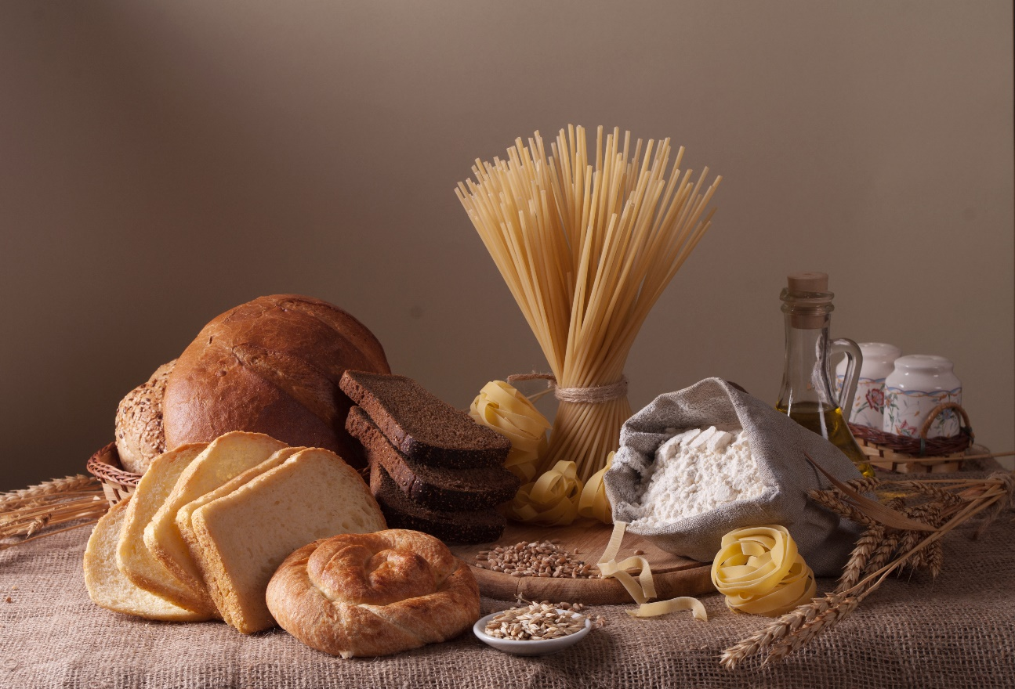
Whole Grains Make Great Food!
Great food starts with great ingredients. At Whole Grains Bread, we strive to gather the finest, freshest ingredients to ensure quality products. You’ll taste the difference when you buy Whole Grains!
FRESH TO YOU EACH DAY!

Slide 5
Whole Grains Catering
Restaurant service
Custom catering for large parties
Do-it-yourself party platters
Full line of bread products
Homemade soups
Gourmet sandwiches

Slide 6
Catering Bread Pricing
Item | Per Item | Dozen/Per Item | Two Dozen/Per Item
Bread | $3.50 | $2.99 | $1.99
Croissants | $2.00 | $1.75 | $1.25
Bagels | $0.90 | $0.60 | $0.45
Baguettes | $2.50 | $2.00 | $1.75
Muffins | $1.50 | $1.25 | $1.00

