Slide 1
Restoration Architecture
Design For Life—Design That Lasts

Slide 2
We Offer . . .
Excellent customer service
Advanced project management methods
Environmentally friendly building materials
Superior design work
Notes:
We are experts in LEED construction, the standard for eco-friendly building.

Slide 3
What Sets Us Apart
Client diversity
Reasonable fees
Expertise with many architectural styles
Client/designer interaction

Slide 4
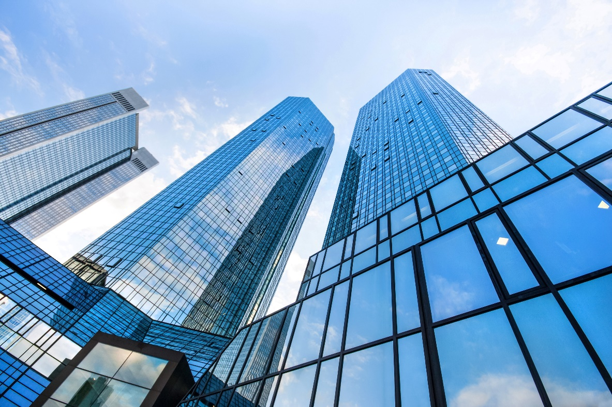
Member of American Institute of Architects
We are proud to belong to the AIA. All of our architects have 8–10 years of experience. Our Cost Control™ design process is recognized as a sound method for adhering to budgets and promoting client satisfaction.
Notes:
Give more information on Cost Control.

Slide 5
Company Structure
Owner/President
Jim Kendrick
Hector Martinez
Managing Architect
Marilyn Stewart
Designer
Paul Tewkes
Operations Manager
Mary Frank
Marketing Manager
Mark Randall
Assistant
Alice Wilson
Assistant
Colin Smith
Marketing Associate

Slide 6
Client Breakdown
Notes:
Emphasize the focus on residential projects.

Slide 7
You’re Part of the Process
1
You contact us
2
We visit your site
3
We prepare a design and budget
4
You accept the design and budget
5
We start work
Notes:
Emphasize “You”!

Slide 8
Site Study Services

Slide 9
Planning Services Price List
Service | Zone 1 | Zone 2 | Zone 3
Permits | $100 | $250 | $150
Site Study | $1,500 | $2,250 | $3,000
Planning | $60/hour | $70/hour | $85/hour
Design | $125/hour | $150/hour | $300/hour

Slide 10
Take Care of Your Most Important Investment
Odds are, you have spent more on your house than on any other single item in your investment portfolio. Your home is not merely a roof over your head, it is long-term security.
Safeguard your investment by taking care of the fabric of your house. We can help you renovate and upgrade systems to ensure your home shelters you now and in the future.

Slide 11
Restoration Gallery
The following slides show only a few of the restoration projects we have completed in the past ten years.
Notes:
Many other before and after photos are available on the Web site.

Slide 12
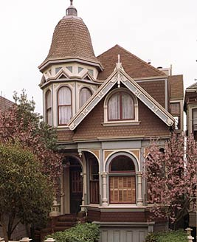
Queen Anne Style
22 Hastings Street
Rose Hill
$132,333

Slide 13
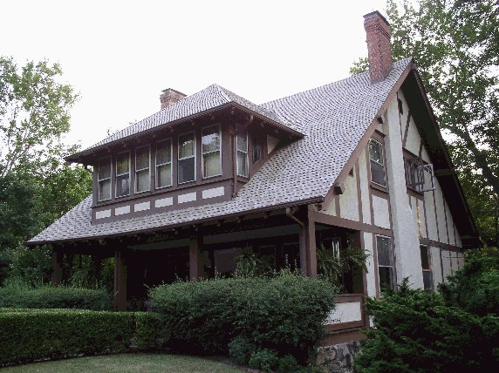
Tudor Revival Style
4 Bellevue Avenue
Hyde Park
$101,993

Slide 14
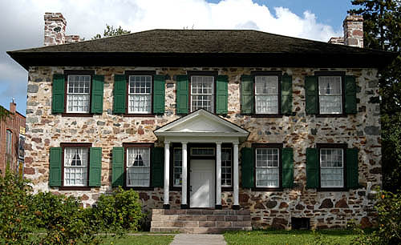
Georgian Style
123 Elm Street
Mt. Lookout
$114,432

