Slide 1
Whole Grains Bread
FRESH TO YOU EVERY DAY

Slide 2
A Selection of Baked Goods
Breads
Croissants
Bagels
Muffins
Rolls
Pies
Tarts
Pastries
Cookies
Cakes

Slide 3
Café Branches Around the West
Offering a wide range of soups, sandwiches, and salads
Open every day from 7:00 a.m. to 9:00 p.m.

Slide 4
Top Four Reasons to Buy from Us
Quality
Service
Freshness
Value

Slide 5
Fresh Is Best!
Local and imported cheeses
Fair trade coffee and chocolate
Certified organic fruits and vegetables
Gourmet sea salt
Locally grown herbs
Whole grain flours
Fresh creamery butter
Free range eggs
Turbinado sugar
Locally produced honey

Slide 6
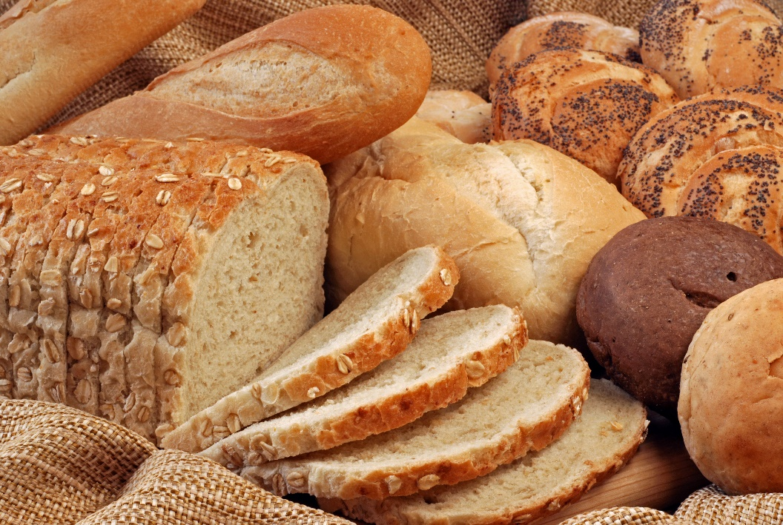
Whole Grains Make Great Food!
Great food starts with great ingredients. At Whole Grains Bread, we try to incorporate the finest, freshest ingredients to ensure quality products. You’ll taste the difference when you buy Whole Grains!

