Slide 1
Campus Recreation Center
Aquatics Program Planning

Slide 3
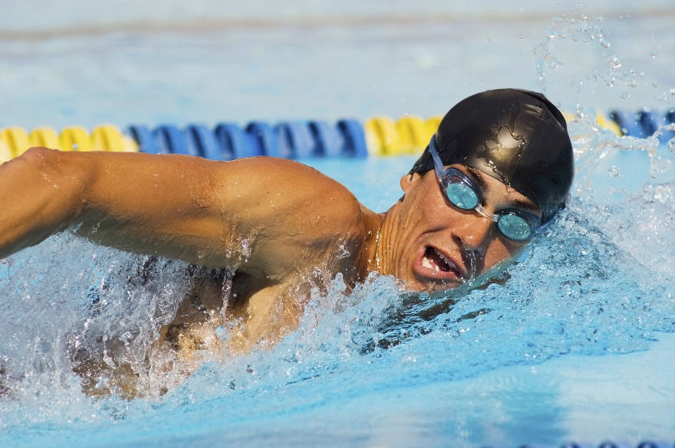
The Issue
The Bédard Aquatics Center at CRC has an Olympic-sized pool that is primarily used in the winter by the swimming and diving team. The rest of the year, it is almost empty seven days a week—except for the occasional lonely lap swimmer or students taking required physical education courses. How can we market this facility to students, faculty and staff, alumni, and community members to keep it busier?

Slide 5
Proposed Logo
Work the water

