Slide 1
Restoration Architecture
Specializing in Redesign and Restoration
Student Name

Slide 2
How Restoration Is Unique
We focus on ways to add value to your property
Our goal is to create a pleasant and functional space
We offer a unique cost-controlling process

Slide 3
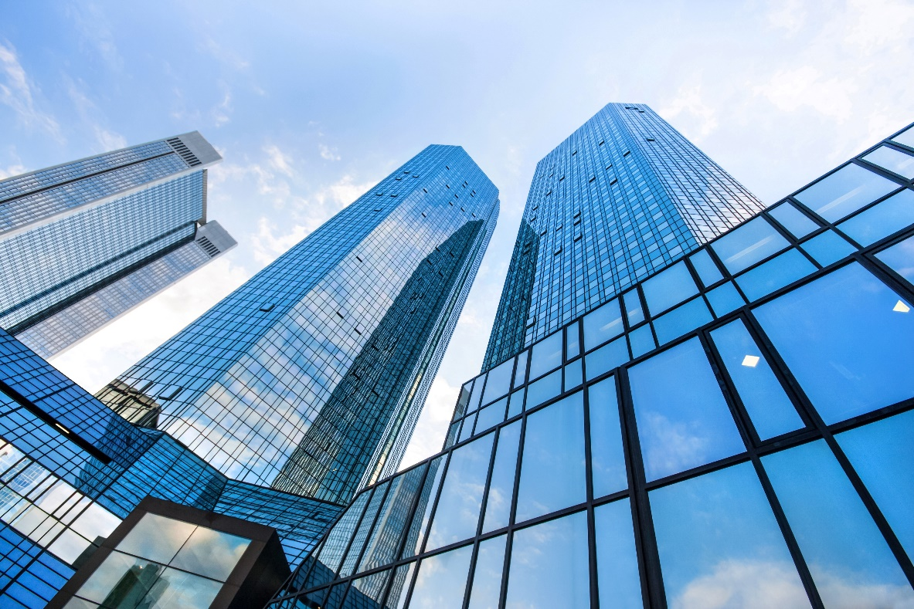
Member of American Institute of Architects
We are proud to belong to the AIA. All of our architects have 8–10 years of experience. Our Cost Control™ design process is recognized as a sound method for adhering to budgets and promoting client satisfaction.

Slide 4
Planning Services
 | Zones
Service | Zone 1 | Zone 2 | Zone 3 | Zone 4
Site Study | $2,000 | $2,500 | $5,000 | $3,000
Planning | $75/hour | $85/hour | $90/hour | $80/hour
Design | $150/hour | $250/hour | $400/hour | $200/hour

