Slide 1
Medi-Ready Urgent Care
Timely—Convenient—Affordable

Slide 2
Medi-Ready Is Ready to Serve You!
Now open in Madison Plaza
Hours:
Open 7 days a week
9:00 a.m. to 10:00 p.m.
Call for your appointment or walk in
Our friendly staff is waiting for you

Slide 3
How We Can Help
Injuries
Illnesses
Vaccinations and Diagnostic Tests
Household accidents
Work-related injuries
From the common cold to seasonal flu
Treatment for chronic as well as acute conditions
Routine vaccinations
Blood work and monitoring

Slide 4
Injuries and Illnesses
Personal Injuries
Illnesses
Fractures and dislocations
Sprains and strains
Cuts and lacerations
Dog bites
Burns
Minor eye injuries
Colds and flu
Sore throat, coughs, and sinus infections
Poison ivy and other rashes
Earache and headache
Pneumonia and bronchitis
Heart and high blood pressure

Slide 5
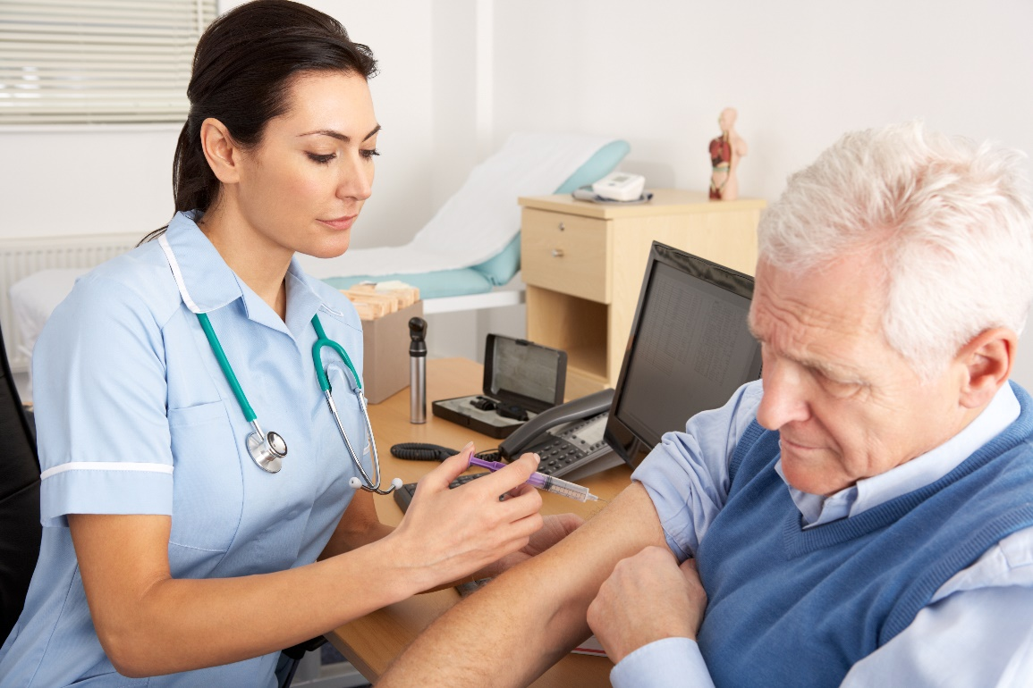
Vaccinations
Travelers vaccinations
Flu shots
Routine childhood vaccinations
Whooping cough supplemental vaccinations
Shingles vaccinations
Hepatitis A & B
Tetanus shots

Slide 6
Diagnostic Tests
Lab work
Routine screening tests
X-rays
EKG
Ultrasound

