Slide 1
Medi-Ready Urgent Care
Timely
Convenient
Affordable

Slide 2
Medi-Ready is Ready to Serve You!
Now open in Madison Plaza
Hours:
Open 7 days a week
9:00 a.m. to 10:00 p.m.
Call for your appointment or walk in
Our friendly staff is waiting for you

Slide 3
Injuries and Illnesses
Personal Injuries
Illnesses
Fractures and dislocations
Sprains and strains
Cuts and lacerations
Dog bites
Burns
Minor eye injuries
Colds and flu
Sore throat, coughs, and sinus infections
Poison ivy and other rashes
Earache and headache
Pneumonia and bronchitis
Heart and high blood pressure

Slide 4
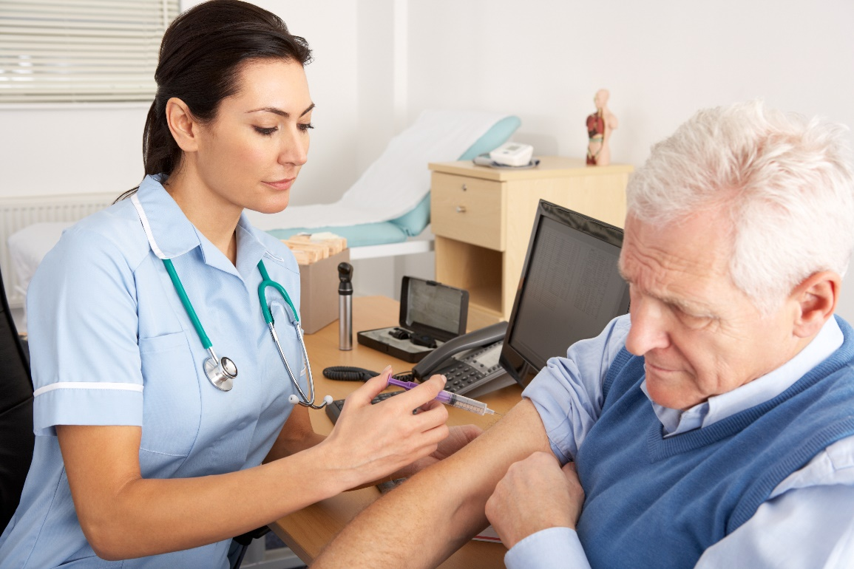
Vaccinations
Travelers vaccinations
Flu shots
Routine childhood vaccinations
Whooping cough supplemental vaccinations
Shingles vaccinations
Hepatitis A & B
Tetanus shots

Slide 5
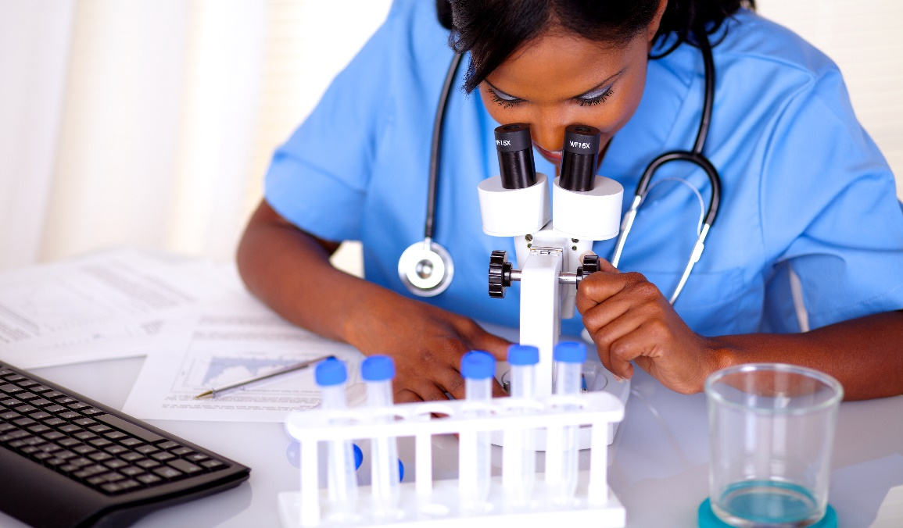
Diagnostic Tests
Lab work
Routine screening tests
X-rays
EKG
Ultrasound

