Slide 1
Wynnedale Medical Center
Laser Eye Surgery Unit
Find out if Laser Surgery is right for you

Slide 2
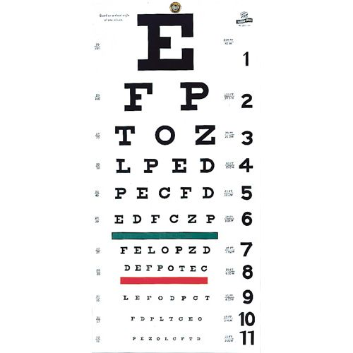
Laser Eye Surgery Unit
Opens March 22
Headed by Dr. Martin Talbot from the Eastern Eye Surgery Clinic
State-of-the-art facilities and staff
Awarded Best Eye Care Facility in 2019
Surgeons recognized as one of the most experienced teams in the country
This Photo by Unknown Author is licensed under CC BY-NC-ND

Slide 3
A First Look at Laser Surgery
Safe, fast, and reliable
Covered by most insurance carriers
The key to clear vision
Relative lack of pain
Almost immediate results (within 24 hours)

Slide 4
Is Laser Surgery for You?
Pros
Cons
Virtually painless
Fast procedure
Immediate improvement
Covered by most insurance plans
Not everybody is a candidate
Cost
Some risk of corneal damage

Slide 5
Laser Eye Surgery Facts
LASIK is the most common refractive surgery
LASIK corrects near-sightedness and astigmatism
Uncorrected vision may be 20/40 or better after surgery
Other options include PRK and LASEK

Slide 6
The Cost of Laser Surgery
Typically as low as $499 per eye
Custom options can add to costs
Financing is available for some candidates
Notes:
Compare the cost of surgery to the cost of glasses or contacts.

Slide 7
Clear Vision in a Day
In most cases, vision clears immediately, or within 24 hours of surgery. The patient should be able to return to normal activities in a day and feel no discomfort or side effects from the surgery.
Notes:
Make sure potential patients know that the surgery is painless.

