Slide 1
Chapter 16
Web Media
© 2013 Cengage Learning. All Rights Reserved. May not be scanned, copied or duplicated, or posted to a publicly accessible website, in whole or in part.

Slide 2
Lessons
Lesson 16.1 Adding Sound and Video to Web Pages
Lesson 16.2 Creating Podcasts

Slide 3
Learning Outcomes
16.1 Compare sound formats and determine which are best for Web pages
16.2 Explain the difference between streaming and downloadable media
16.3 Describe the methods for adding media to a Web site
16.4 Follow the necessary steps to add media to a Web site
16.5 Give examples of how podcasts are used
16.6 Create a podcast and add a feed

Slide 4
Sound File Formats
Lossless compression files are essentially copies of the original source
Common formats are the Windows-based WAV (for WAVeform Audio Format) and the Mac-based AIFF (for Audio Interchange File Format)
Because they are near-copies of the original, they lend themselves to archiving and being used as a master
Distribution copies tend to be lossy because they are much, much smaller
They reduce the size of an audio recording by eliminating some of the data
The most well-known lossy file format is the MP3 format, but there are several others, including WMA (Windows Media Audio), Apple’s AAC (Advanced Audio Coding), and RM (RealMedia)

Slide 5
Sound File Formats (continued)
You should use a lossy compression for sound on a Web page to minimize download time
Which format you use depends on several factors, including:
File size
The platforms (computers or mobile devices, for instance) that visitors to your Web site will use
Quality issues
The most universally accepted file format is MP3
Broadband (high-speed Internet) connections are excellent for playing Web media

Slide 6
Streaming or Downloading
Streaming is a process that allows a media file to begin to play before it has completely loaded onto a Web page
In order to stream, the audio file must be converted to a lossy compressed format
Encoding software changes media files from one format to another and can be used to create streaming media
Other output option is to make the file downloadable

Slide 7
Placing the Sound on the Page
Three ways to place the sound on the page:
Embedding the sound file
Embedding a media player
Adding a hyperlink
The term embedding indicates that the sound file will reside on the Web page
Embedding the Sound File
If you place the sound in the <head> of the page and use the autoplay command, it will play as soon as the page is open, without giving the user any control over the sound
One way around automatic play is to include some simple controls for the Web visitor to use

Slide 8
Placing the Sound on the Page (continued)
Embedding the Sound File (cont.)
You can use HTML5 (a newer markup language supported by the W3C) to include both a sound file and a small audio player on your Web page
By adding the autoplay attribute and setting the value to false, you ensure that site visitors will have to activate the player to hear the sound, rather than it playing automatically
HTML5 is not yet finalized (at time of this writing) by the W3C and not all browsers support all tags

Slide 9
Do You Want to Hear Music?
When you’re placing media in a Web site, it’s a good thing to put yourself first in the position of a visitor to the site
How will they experience a particular feature?
Only include the feature if you think it would truly be appealing or useful to potential visitors

Slide 10
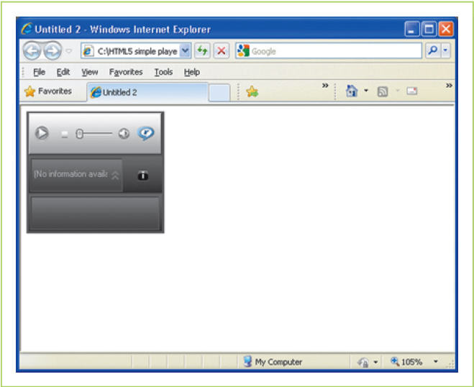
Placing the Sound on the Page (continued)
Embedding a Media Player
Another option for placing sound in your Web page is to write code that will insert one of the top media players
Each of the programs has a unique identifier called the classid that must be included

Slide 11
Placing the Sound on the Page (continued)
Using a Hyperlink
Simplest method for making a sound file available to Web visitors is to keep it on the Web server and create a hyperlink within the Web site
Keeps the audio optional for the user without adding features to the page that might slow down the Web visitor’s browser

Slide 12
Video
The main problem with videos is that file sizes are much larger, so download time can be a barrier
It is very important to make them streaming
The file types for movies fall into three basic categories: Apple Quick- Time (MOV), Windows Media Player (MPG and AVI), and RealPlayer (RAM)
To help reduce file size, keep the size of the video screen small
Video quality: 30 frames per second makes for smooth video but a larger file size; 10 fps produces very choppy motion and a much smaller file size
Methods for placing video on a Web site are the same as those for placing audio

Slide 13
Creating Podcasts
Podcasting is a means of providing downloadable audio or video (via the Internet) to anyone who wishes to access the media content
The name podcasting results from combining the words iPod and broadcasting
Podcasts are similar to radio or televisions shows that were once recorded on audiocassettes, videocassettes, or, more recently, on a digital video recorder
The advantage of podcasts is that site visitors can download the files and then hear or view the broadcast whenever they want

Slide 14
Podcasts, Blogs, and Shared Media Sites
What makes technologies like podcasts, social networking sites, or media sharing sites so popular?
What can a business do to make its offerings stand out in these environments?

Slide 15
Podcasts and XML
Podcasts are made available using XML files
XML (for eXtensible Markup Language) is a markup language specifically designed to hold and move data
XML and HTML differ in several ways:
XML holds packets of data; HTML describes how the data is to be displayed
XML does not have any set tags; HTML does
XML keeps the data separate from the method of presentation
XML is more device independent
XHTML is a combination of XML and HTML
W3C recommends using a styling language called XSLT (for eXtensible Stylesheet Language Transformations)

Slide 16
Steps in Creating a Podcast
Making a podcast involves four basic steps:
Creating the media file
Saving the file in a downloadable form
Posting the file to a Web server
Inviting subscribers to your podcast
Podcasters can choose from among several different tools to increase the visibility of their podcasts and invite visitors to become subscribers
A subscriber is a Web visitor who accepts notification of any updates to a podcast or a Web site that has frequently changing content)

Slide 17
Steps in Creating a Podcast (continued)
Creating the Media File
Keep the content focused
Be prepared before recording
Be sure that all participants can be equally heard
Share the microphone
Be conscious of your audience
Avoid distracting background noise
With video, keep the camera steady

Slide 18
Steps in Creating a Podcast (continued)
Saving the File
Podcasts are saved in the same file formats as other audio and video files meant for the Web
For audio podcasts, MP3 files are the ideal choice
For video files, it is probably best to save the file in more than one format, such as:
.MOV for QuickTime
.WMV for Windows Media Player
The H.264 format (a video format that is highly compressed and can be played across many platforms)

Slide 19
Steps in Creating a Podcast (continued)
Posting the File to a Web Server
Some companies have their own Web servers, which host their Internet sites; IT staff can provide guidance on uploading podcast files
If a company purchases Web hosting from a service, its staff will also provide instructions
Posting the files will be similar to the process for posting Web pages
It is possible to create podcasts without having a dedicated Web server; the Internet has free podcast media hosting sites
Another way to post a podcast is by opening a free blog on a site such as WordPress or Blogger

Slide 20
Steps in Creating a Podcast (continued)
Inviting Subscribers to Your Podcast
The final step in podcasting is getting your podcast recognized; one method is to use a tool like Google’s free FeedBurner
A feed is any electronic content and the process by which that content is syndicated
Two types of feeds:
The RSS feed is one standard for syndicating Web content; the older standard
Atom was developed more recently
An aggregator is software that collects and lists Web sites that have been syndicated

Slide 21
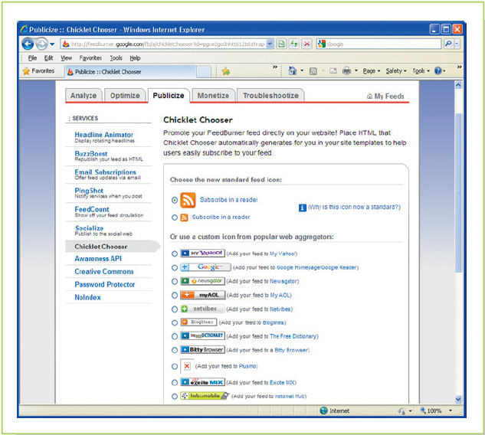
Steps in Creating a Podcast (continued)
Inviting Subscribers to Your Podcast
The FeedBurner service allows you to enter a category for your podcast so it will be listed in appropriate areas of iTunes and Yahoo’s Media RSS aggregator
You can enter a description and keywords to provide more information about the podcast site
Each time you create a new podcast, FeedBurner will automatically recognize it and make that information available to anyone who subscribes to your site
You can also use FeedBurner to add icons (called “chicklets” by the program) representing any of several aggregators

Slide 22
Key Concepts
Choosing a file format for audio files to be posted on the Web is a matter of balancing quality, file size, and accessibility
Some file formats are only available on some platforms, or operating systems and devices
The MP3 format, which is data compressed to a small size, is still the file format of choice because it can be played on a wide variety of systems
Media files can be streamed or downloadable; streaming saves time for the user by making it possible for Web visitors to listen to or hear the file before the whole file is downloaded.

Slide 23
Key Concepts (continued)
There are three methods for posting media on a Web site:
To embed it by writing the code to place the media in either the head or in the body with buttons or some other controls
To embed a media player along with the media by writing code to call up the media player, referring to the specific classid of the player;
To create a hyperlink that sends the Web visitor to another page to obtain the media, using the standard tags for creating a hyperlink
Video should be streamed rather than downloadable because files can be very large; making the screen size smaller can help keep file size small

Slide 24
Key Concepts (continued)
Another way to make media available to Web visitors is in podcasts, which create downloadable media packets and invite users to subscribe to the service and be notified of updates
Media companies use podcasts to make programs available to listeners and viewers
Businesses may post podcasts of important product announcements or other company news or to give consumers information
Preparing for a podcast, whether an audio or video version, helps make a presentation of good quality

Slide 25
Key Concepts (continued)
Podcast files should be saved in a downloadable format
They can be saved to a company-owned server or to a Web hosting service, whether it’s paid for or free.
After uploading the file to the server, it is necessary to publish a link to the file, which can be done simply by creating a blog with a link to the media
To make a podcast visible, the podcaster should set up a subscription service like an RSS feed that will be noticed by podcast aggregators and thus notify subscribers of updated content

