Slide 1
Chapter 11
Audio
© 2013 Cengage Learning. All Rights Reserved. May not be scanned, copied or duplicated, or posted to a publicly accessible website, in whole or in part.

Slide 2
Lessons
Lesson 11.1: Managing Audio Files
Lesson 11.2: Sound Equipment
Lesson 11.3: Capturing and Editing Sound

Slide 3
Learning Outcomes
11.1 Distinguish between sampling options for sound
11.2 Make choices to reduce the size of sound files
11.3 Select an audio file type for the appropriate use
11.4 Observe the differences in ports found on sound cards
11.5 Set up a microphone and record sound
11.6 Modify audio files using a wave editor

Slide 4
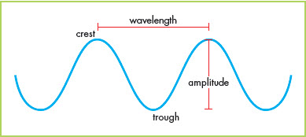
Managing Audio Files
Analog audio is recorded as a series of waves reproducing approximately what the human ear hears
Digital audio is created using a series of zeros and ones, with the computer reading the variations to play back what was recorded
Frequency is measured in Hertz (Hz) or thousands of Hertz (KHz); the Hertz value of a sound shows the number of times each second that the wave pattern of sound repeats

Slide 5
Sampling
To reduce the size of the file, digital recording software “grabs” sound at set intervals called a sample rate
The higher the sample rate, the better the audio quality and the larger the file size
Sample size reflects the number of bits used to represent the sound in a sample
The more bits, the more information provided

Slide 6
Channels
Channels are the number of sides from which sound is heard, either mono (one) or stereo (two)
With stereo, sound is recorded as if coming from slightly different directions
Monaural sound only records a sound from a single side
When a multimedia computer has two speakers, stereo sound is possible
Since stereo audio has more information, files are larger than those for a mono recording

Slide 7
Codecs
Codec stands for compressor-decompressor or, as is also commonly used, coder-decoder
A codec is an algorithm that compresses sound or video to reduce its file size and then decompresses it when played
Some audio codecs are designed for speech, which uses a narrower range of frequencies than music; therefore, speech files can be compressed further than can music files

Slide 8
Codecs (continued)
Audio files with lossless compression are essentially copies of the original
Lossless audio files are used by music studios to store music digitally with full fidelity and for archival purposes
Files created with lossy compression are much smaller than those created with lossless compression
Lossless audio files include, but are not limited to:
WAV
AIFF
AU
The most popular audio files use lossy compression, of which three are common:
MP3
AAC
WMA

Slide 9
Organization
Good organizational skills help you stay focused, allow you to be more productive, and prevent you from wasting time
Keep supplies and materials in the same place so you know where they are the next time you need them
Give your electronic files and folders descriptive names so that you can find them easily
Avoid unnecessary complication
Break down large tasks into smaller pieces
Create a to-do list to help keep you focused

Slide 10
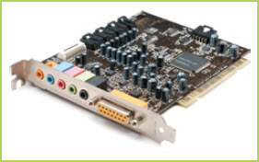
Sound Equipment
A sound card is a computer component that allows computers to play or record sound
DAC is the acronym used to describe the process of converting sound from digital to analog
ADC is the acronym used to describe the process of converting sound from analog to digital
Kostyantyn Holovanov/Shutterstock.com

Slide 11
Speakers and Headphones
Speakers for computers come in a wide range of sizes, designs, and costs
A subwoofer is a speaker that reproduces very low bass sounds
Speakers connect to jacks on the sound card
Orange Subwoofer and center out
Light blue Stereo line in
Pink Microphone
Lime green Line out, front speakers, or headphones
Black Rear speakers for 5.1 and 7.1 surround sound systems
Gray Middle speakers for 7.1 surround sound systems
Gold MIDI/game port (joystick)

Slide 12
Speakers and Headphones (continued)
Speaker Safety
Too much volume can cause the cone that vibrates in a subwoofer to tear
Too much power can also actually melt a part in the speaker called a voice coil
High volume levels can pose danger to your hearing and the hearing of those around you
High volume can also be a distraction—or an annoyance—to those around you

Slide 13
Speakers and Headphones (continued)
Headphone Safety
The biggest concern over use of computer headphones is personal safety; it is easy to turn up the volume to a dangerous level
Turn the sound all the way down before you put headphones on since the sound is often much louder in the confined space of headphones compared to what you hear coming from speakers

Slide 14
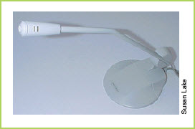
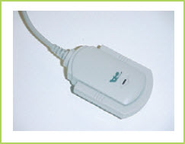
Microphones
There are several types of microphone available on the market:
Headset
Lapel
Handheld
Mounted

Slide 15
MIDI
MIDI (Musical Instrument Digital Interface) is an interface between a computer and a musical instrument that transmits notes and other details between the two
Doesn’t record the vibrations or sounds
Records the notes that were played and other information, such as the length of time the note was held
Musical compositions can be written and modified on a computer and then transmitted to a MIDI-connected instrument for playing

Slide 16
How Important is Sound?
Why do you think that sound cards were not included in early computers?
Is audio an essential part of your computer usage?
Could you manage without it?

Slide 17
Sound Editors
A wave editor is software that allows you to modify or edit audio files
Sound editors can be used to convert sound from one format to another and provide tools once reserved for complex sound-recording studios:
Add special effects
Insert one sound into another
Edit out sound that you want to remove

Slide 18
Sound Editors (continued)
Recording Audio
Wave editors allow you to record sound using simple tool bars
When recording, it is good to leave a second or so of silence at the beginning and end of each recording
Editing Audio
The waveform view is a graphical display that represents the changes in recorded sound waves
You can insert new sounds or create a spot of silence within a noisy recording
You can add additional tracks to the recording

Slide 19
Exporting Files
You can export to the file format you want depending upon the intended use
Ripping is the process of transferring music from a CD to a computer
Keep copyright law in mind
It is considered fair use to include previously recorded music in a school presentation
It is a violation of copyright law to post a multimedia project on a commercial Web site without first obtaining permission for any previously recorded music

Slide 20
Key Concepts
Analog audio and digital audio work in combination
Computers acquire analog sounds and convert them to digital, or read digital files and output them in an analog format
Analog is what you hear
Digital is the means of capturing it in software
Audio file sizes are determined by sample size and rate, by the number of channels recorded, and by the codec used to compress them
Audio file types consist of two types:
Those compressed with lossless algorithms
Those that are created using lossy algorithms

Slide 21
Key Concepts (continued)
Speakers and headphones are connected to a computer sound card using a variety of color-coded or icon-identified ports, or jacks; they provide audio output
Microphones are used to capture audio files including voice and music; they are input devices
Sound or wave editors are used to record audio files and then to edit them
Because files are digital, the data can be edited precisely, just as image files can be
Editing can include cutting, adding effects, and mixing multiple tracks together into one file

