Slide 1
Chapter 7
Vector Editing
© 2013 Cengage Learning. All Rights Reserved. May not be scanned, copied or duplicated, or posted to a publicly accessible website, in whole or in part.

Slide 2
Lessons
Lesson 7.1: Understanding Essential Vector Terminology
Lesson 7.2: Working with Objects
Lesson 7.3: Converting Raster Images to Vector Objects by Tracing

Slide 3
Learning Outcomes
7.1: Recognize the essential elements of a vector object and use vector terminology
7.2: Draw simple shapes and lines using vector drawing tools
7.3: Draw straight or curved paths segment by segment
7.4: Transform objects using a selection tool and a bounding box
7.5: Adjust curves
7.6: Stack and reorder objects
7.7: Create a clipping mask
7.8: Convert a raster image into a vector object using a tracing feature

Slide 4
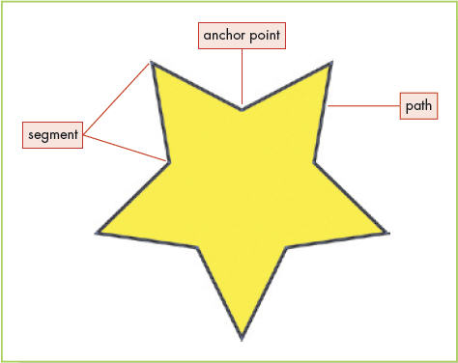
Anatomy of a Path
The lines in a vector image are usually called paths by most vector applications
A closed path refers to objects without a clear beginning and end such as a circle, square, or other shape
An open path refers to a path with a distinct beginning and end such as a single straight, curved, or wavy line
Each path includes one or more segments, which can be either straight or curved

Slide 5
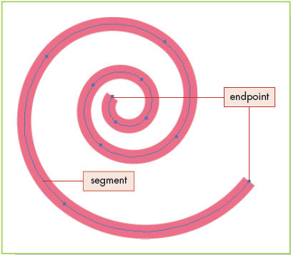
Anatomy of a Path (continued)
The beginning and end of each segment on a path is marked by anchor points (sometimes referred to as nodes in certain vector programs)
Distinct anchor points at the beginning and end of a path are referred to as endpoints
Anchor points along the path where the angle changes are called corner points
Anchors along a curve are called smooth points

Slide 6
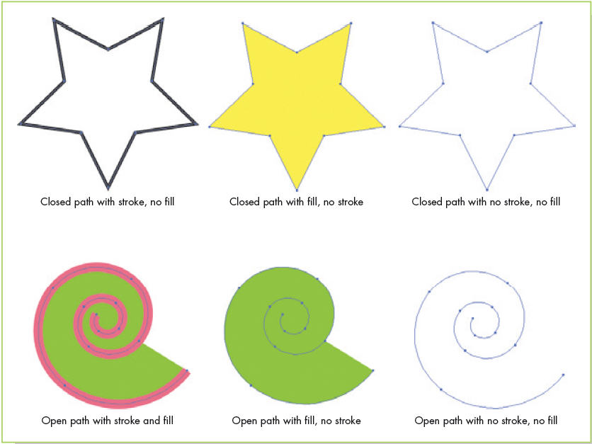
Stokes and Fills
The visible outline of a path is called a stroke (or an outline)
A fill is a color or pattern applied to the inside of a path

Slide 7
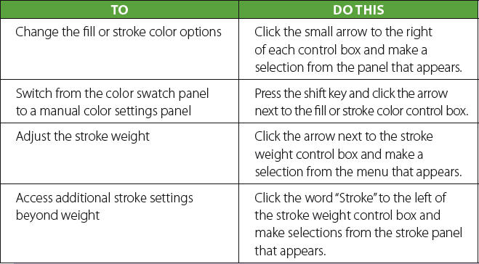
Stokes and Fills (continued)
Using the Control panel in Illustrator to adjust fill and stroke options

Slide 8
Raster vs. Vector Software
Why is it important for a graphic artist to be familiar with both raster and vector editing software?
Is one graphic format easier for you to grasp than the other?

Slide 9
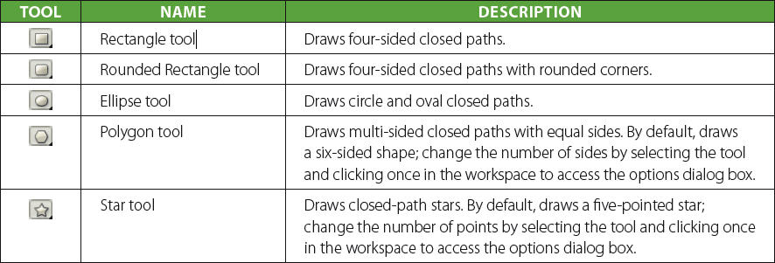
Drawing Simple Shapes and Lines
Shape tools are vector drawing tools that enable a user to draw common, closed path shapes with ease and efficiency
When you draw with a shape tool, anchor points and segments are automatically added along the path of the object

Slide 10
Drawing Simple Shapes and Lines (continued)
A line tool draws open path line segments
Anchor points and segments are automatically added to objects you draw with a line tool

Slide 11
Drawing Straight and Curved Segments with a Pen Tool
The Pen tool (or Bezier tool in CorelDRAW) enables you to draw objects by placing anchor points one at a time
Drawing an object with a pen tool requires a series of clicks
Click once on the workspace where you would like a line to begin; this places an anchor point
Move the insertion point to the spot where you want the line segment to end and click again; another anchor point appears and a line segment connects the two points
To end the path (in Illustrator), press Ctrl + Click (PC) or Command + Click (Mac)

Slide 12
Drawing Straight and Curved Segments with a Pen Tool (continued)
To draw straight line segments
(A) Set the first anchor point with a mouse click
(B) Set a second anchor point with a mouse click and a line is drawn
(C) Set two more anchor points and two more line segments are drawn

Slide 13
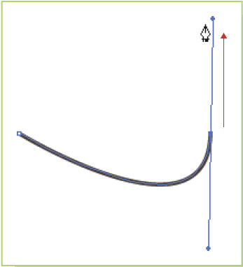
Drawing Straight and Curved Segments with a Pen Tool (continued)
To draw a curved line segment:
Click once on the workspace to set an anchor point
Move the insertion point and click again, holding down the mouse button, and drag

Slide 14
Drawing Straight and Curved Segments with a Pen Tool (continued)
You can draw either open or closed path objects with a pen tool

Slide 15
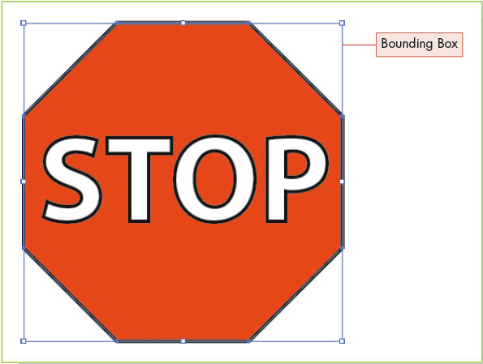
Editing Objects
Using Selection Tools and Bounding Boxes
A bounding box is an outline around a selected vector object that can be used to transform the object

Slide 16
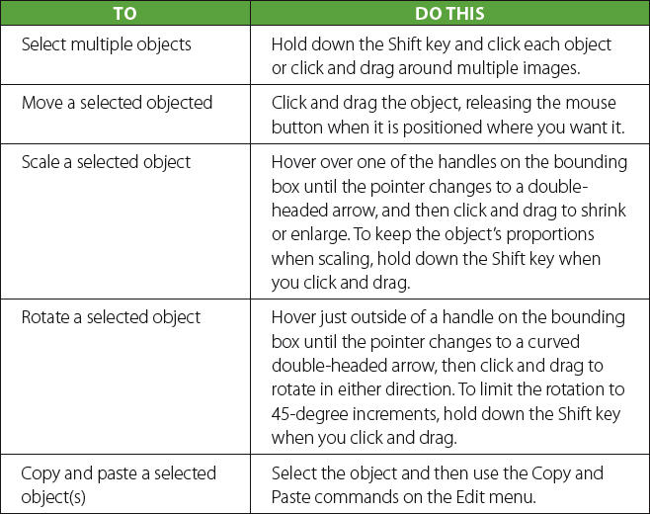
Editing Objects (continued)
Using Selection Tools and Bounding Boxes (continued)
You can use the Selection tool and the bounding box to move, scale (resize), or rotate an object

Slide 17
Editing Objects (continued)
Transforming Curved Segments
In most vector programs, when you select a curved segment, lines (called directional handles) appear at the smooth points on that segment
Directional handles are used to shape curves on a path
The lines on directional handles are called directional lines and are capped at the end with directional points
You can click and drag the directional lines or directional points to reshape and/or resize a curve

Slide 18
Editing Objects (continued)
Rearranging Stacked Objects
You can overlap or stack objects in a vector editing program by clicking an object with the selection tool and dragging it over another object
You can change the order of stacked objects
You can select an object to reorder

Slide 19
Editing Objects (continued)
Creating a Clipping Mask
A clipping mask is a vector object used to hide portions of lower objects in a stack
Similar to a layer mask in a raster editing program
To create a clipping mask in Illustrator, stack two or more objects, select them, and then choose Clipping Mask > Make
The hidden parts of the lower objects are not erased by the clipping mask

Slide 20
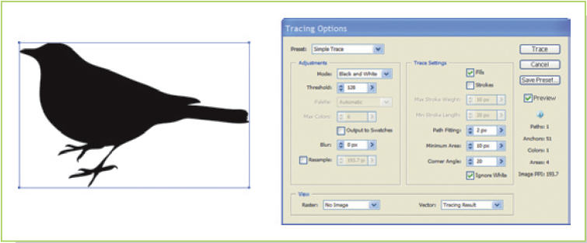
Converting Raster Images to Vector Objects by Tracing
Most vector editing programs include a feature that automatically traces bitmap images and converts them to vector objects
Scan a sketch into a bitmap file and place it in a vector document (or use a photo), trace and convert it to vectors, and then use editing tools to adjust and finalize the image

Slide 21
Image Effects
Is there ever a point where it becomes important to say, “This is good enough”?
Has the ability to make images “perfect” actually improved the effectiveness of the message?

Slide 22
Key Concepts
Vectors are defined by open and closed paths, anchor points, and segments
Strokes and fills are what make a path visible
Shape and line tools make it easy to draw objects with a single stroke or click
Certain tools in vector applications enable you to draw a path by plotting anchor points one at a time
Selection tools can be used to select and transform a whole object or one segment/anchor point at a time

Slide 23
Key Concepts (continued)
Bounding boxes appear around selected vector objects and can be used with a selection tool to quickly transform objects
Directional handles at smooth points on a curved segment control the size and shape of the curve
You can stack and rearrange vector objects
A clipping mask is a vector object used to hide portions of lower objects in a stack
A tracing feature converts bitmap images into editable vector objects

